Slide 1
Pyro Inc. Sales Analysis

Slide 2
Pyro Inc. is Toy Manufacturer Company Located in India
Pyro Inc. Exports in Toys to various Stores Around the World
The Below is Total Sales Analysis of the Pyro Inc.

Slide 3
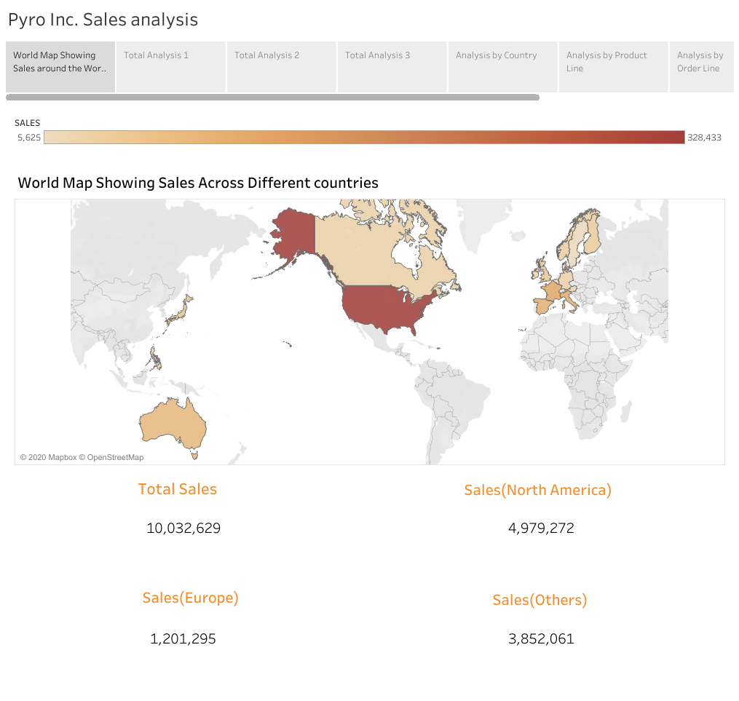

Slide 4
The Map shows the various Countries to which Pyro Inc. Exports its toys
It also gives information About Total sales Across Various continents
To see the Sales By the Particular Country hover Over the Country to see the sales information

Slide 5
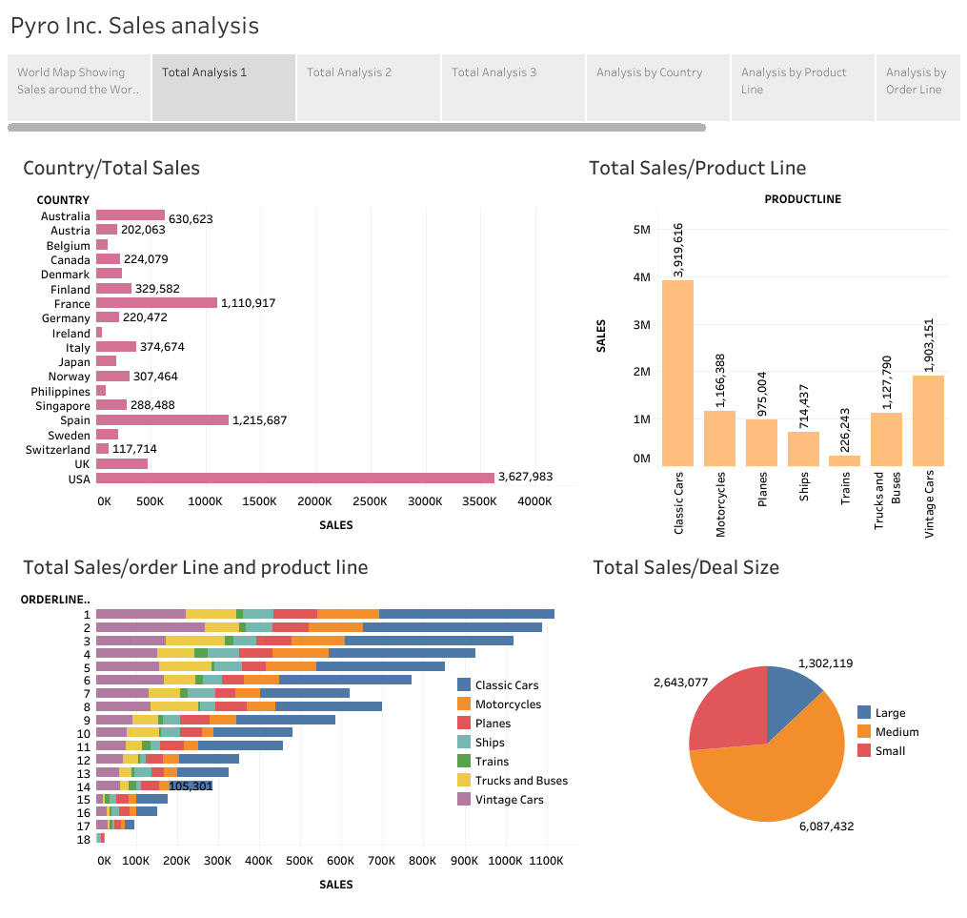

Slide 6
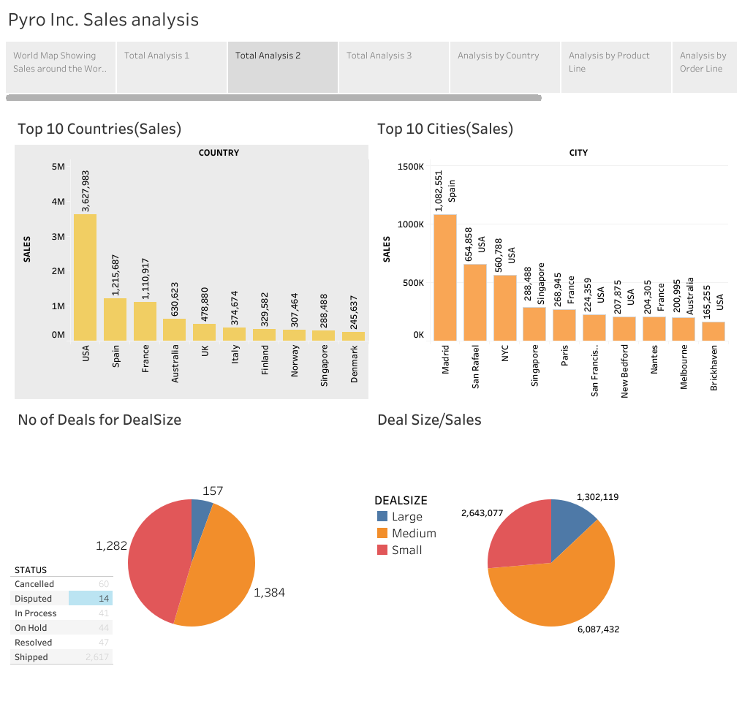

Slide 7
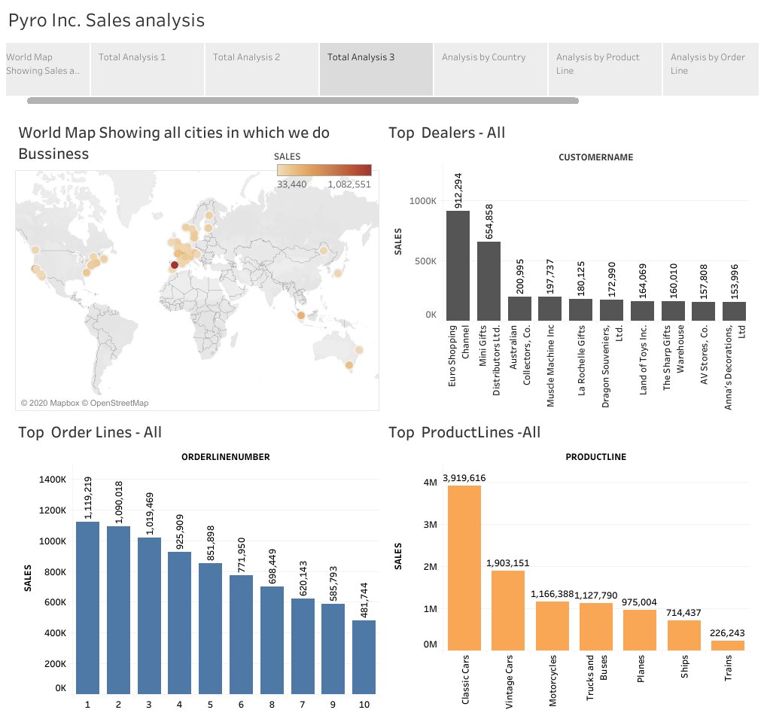

Slide 8
The Above Three Slides present the Total Analysis of Pyro Inc Sales
The First Dashboard shows
The total Sales for each Country
The Total Sales for each Product Line
The Total Sales for each Order Line
The Total Sales for each Deal Size
From the Above Charts we can understand that The USA is Pyro Inc.’s Biggest
Market , Most of sales are happening in order line 1 to 6 and Pyro Usually do
Medium Sized Deals. Half of Pyro Sales comes from Cars Product Line
The Second Dashboard Shows
Top 10 countries by Sales
Top 10 Cites by Sales
No of Orders Taken for Each Deal Size
Sales for Each Deal Size

Slide 9
From the Second Dashboard We can Say though USA is the Pyro’s Biggest market .in terms of Cites Sales Madrid(Spain) Beats USA
The 3rd Dashboard Shows
Top Customers of Pyro
Top 10 Order Lines
Top Product Lines
From that we can Observe that Pyro’s Top Customers are Euro Shopping Channel and Mini Gift Distributors Ltd

Slide 10
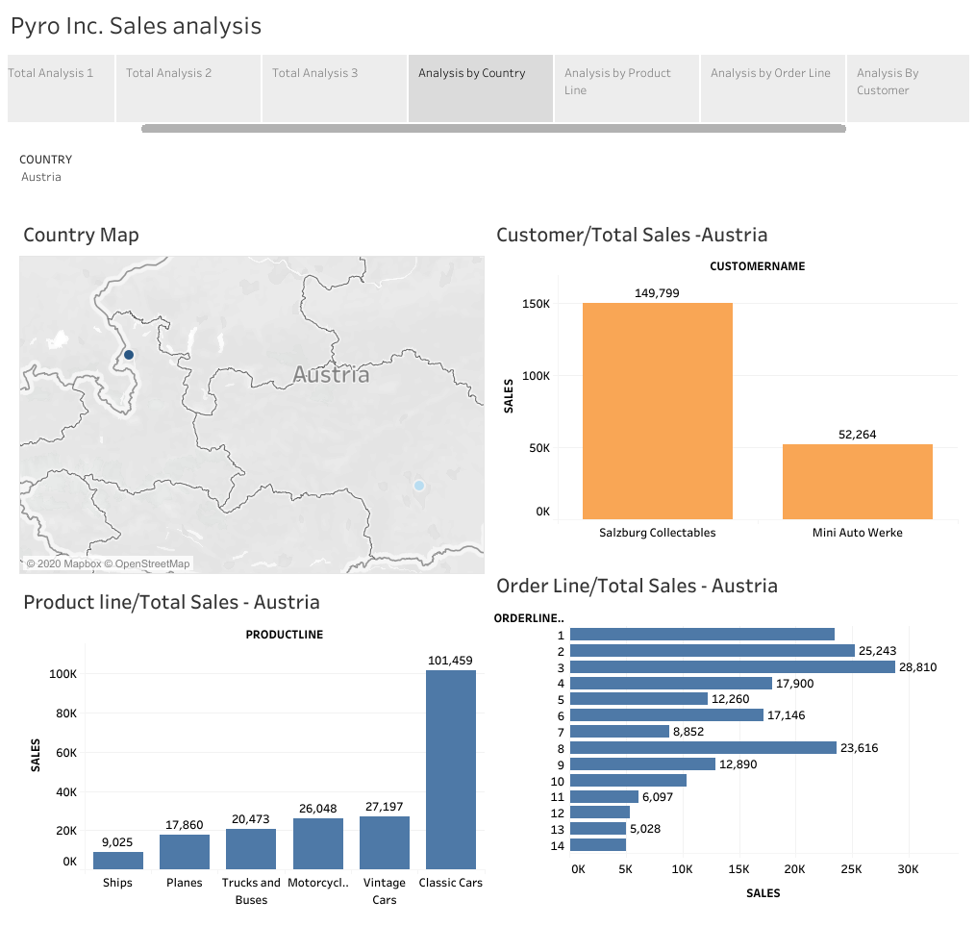

Slide 11
The Above Dashboard Shows the Sales Analysis of Country Austria
In the Dashboard we can Observe
Map of the Country Showing various Vendors in the Country
Top Customers in that Country
Sales by Product Lines in that Country
Sales by Order Lines in that Country
To see the Sales Analysis of the Another Country select the Country Name from the Dropdown list

Slide 12
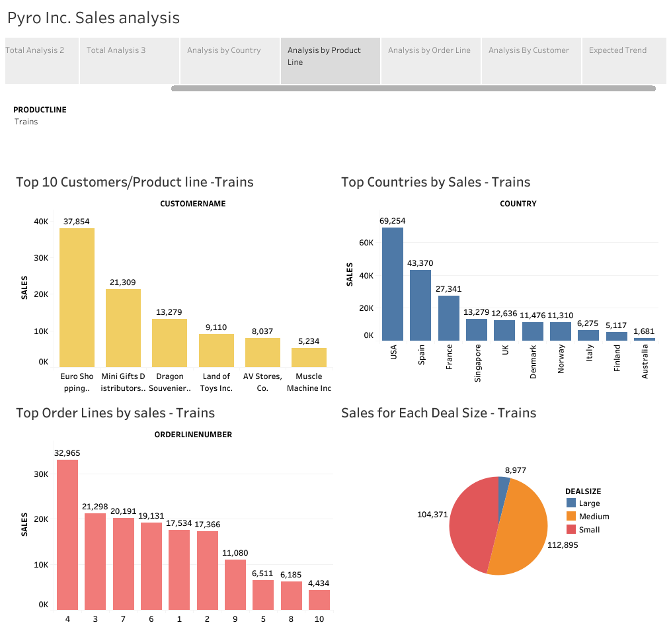

Slide 13
The Above Dashboard Shows the Sales Analysis of Trains Product Line
In the Dashboard we can Observe
Top 10 Customers for that Product Line
Top 10 Country by sales Which Purchase that Product
Top 10 Order Lines by sales from the Product is Ordered
Sales for each Deal size for that Product
To see the Sales Analysis of the Another Product Line select the Product Line Name from the Dropdown list

Slide 14
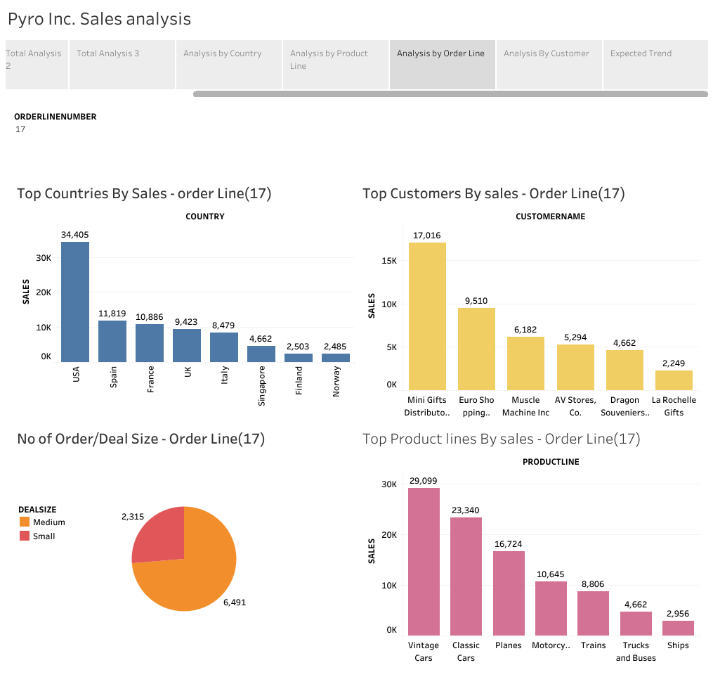

Slide 15
The Above Dashboard Shows the Sales Analysis of Order Line 17
In the Dashboard we can Observe
Top 10 Customers by Sales who order through that Order Line
Top 10 Country by sales Which used that Order Line to Purchase that Products
Top 10 Product Lines by sales from the given Order Line
Sales for each Deal size for that Order Line
To see the Sales Analysis of the Another Order Line select the Order Line Name from the Dropdown list

Slide 16
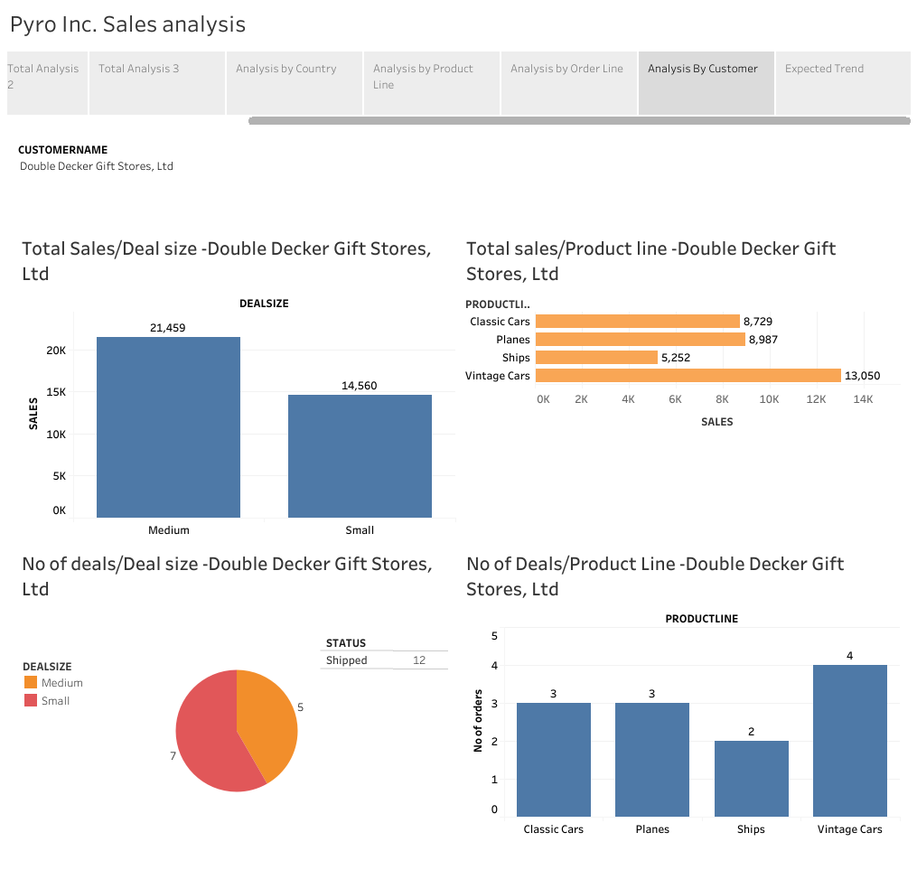

Slide 17
The Above Dashboard Shows the Sales Analysis of a Particular Customer
In the Dashboard we can Observe
Sales Generated through all the Product line for the Given Customer
No of Orders for all the Product line for the Given Customer
No of Deals For Each Deal Size For the Given Customer
Sales for each Deal size for that Order Line
To see the Sales Analysis of the Another Customer select the Customer Name from the Dropdown list

Slide 18
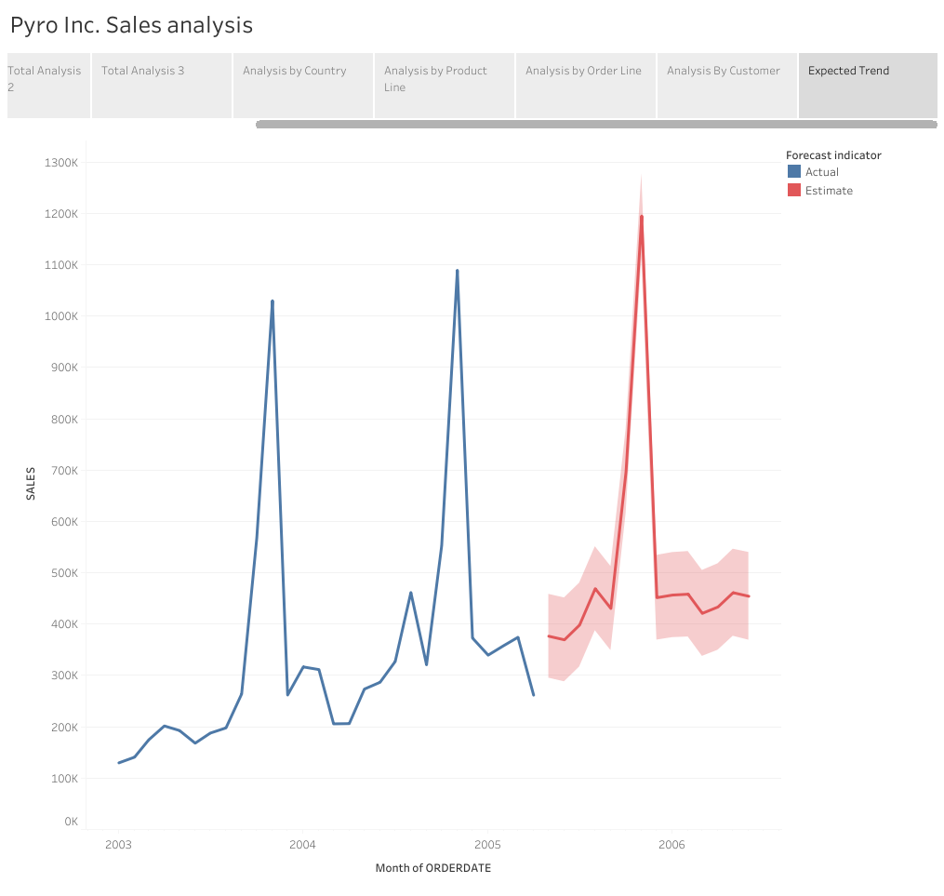

Slide 19
The above Chart Shows the Trend of the Sales for the last Three Years
From that we can Observe that the Sales Sky rock in November
Because of Christmas in December. All Customers order More Toys in November Compared to all Other Months
The Chart also Shows the Future sales Predictions for the Next Year

